Slide 1


Social Buzz’s IPO Journey

Slide 2


Today's agenda
Project recap
Problem
The Analytics team
Process
Insights
Summary

Slide 3

We are running a 3-month initial project for Social Buzz to assist their success in the IPO journey. The following are the main tasks of the project:
An audit of Social Buzz’s big data practice
Recommendations for a successful IPO
An analysis of Social Buzz’s content categories that highlights the top 5 categories with the largest aggregate popularity
Project Recap

Slide 4

Problem
A massive amount of data generated by the product that is urgently required to be analysed to extract useful trends and insights for future development.

Slide 5



Andrew Fleming
(Chief Technical Architect)
The Analytics Team
Marcus Rompton
(Senior Principle)
Terry Li
(Data Analyst)

Slide 6
Process
1
Data Extraction
2
Data Cleaning
3
Data Modelling
4
Data Visualisation
5
Data Analysis

Slide 7
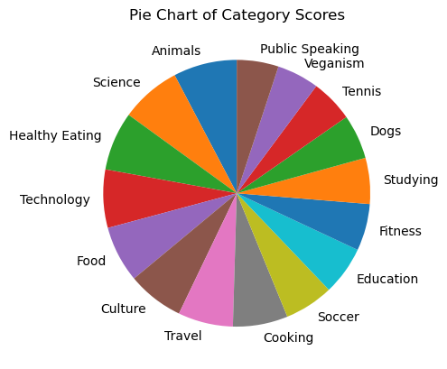

Insights

Slide 8
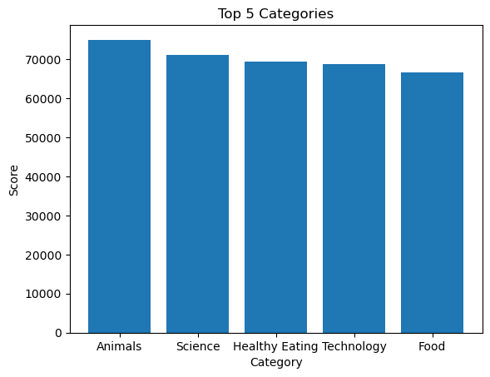

Slide 9
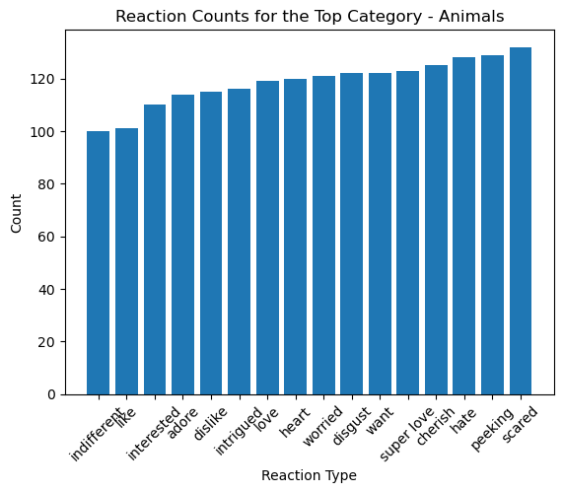

Slide 10
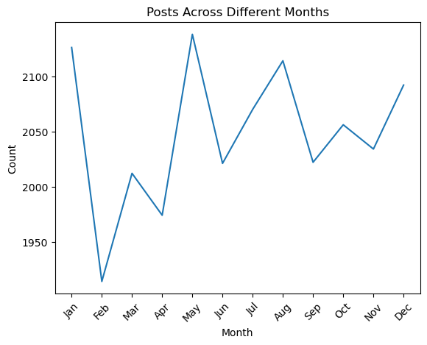

Slide 11

There are 16 categories in total, and most of them receive approximately similar scores.
Top 5 Categories are: Animals, Science, Healthy Eating, Technology, and Food. Average score is around 70000
The top 3 reactions to the top category – Animals are scared, peeking, and hate.
Across the 12 months of the year, we can also observe a peak of posts around May, followed by January with a trough of posts by February.
Summary

Slide 12
Thank you!
ANY QUESTIONS?

